Slide 1
DS 501 Case Study
#1
By Joshua Levy

Slide 2
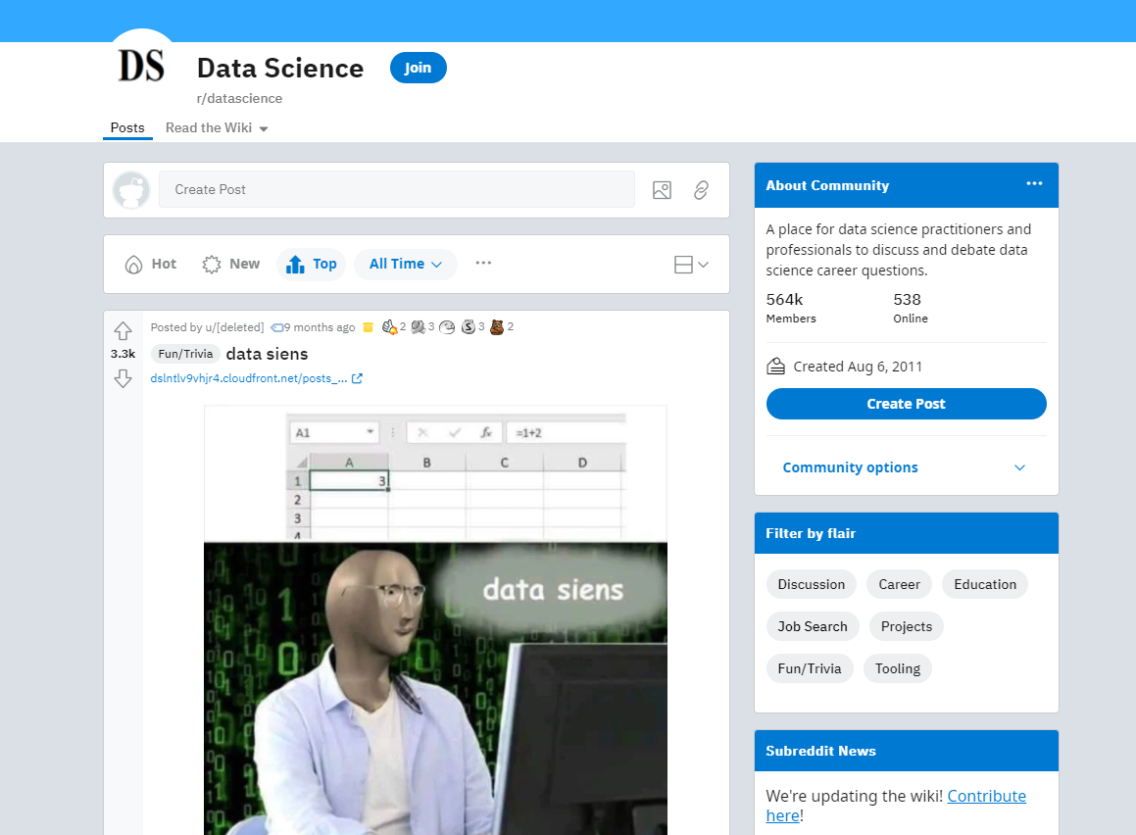
Objective:
Using PRAW create a web scraper to gather post and comment data from the Data Science subreddit.
Posts and Comments must satisfy the following criteria:
Post title length must be greater than 5 words
Post karma must be greater than 50
Post must have been created within the year 2021
Only the top three comments from each post is collected
Posts are sorted and collected from top (rather than hot or new).
The goal of this criteria was to increase relevancy and reduce the number of memes posts collected.
Notes:
Picture shows the current top post in data science which is a meme

Slide 3
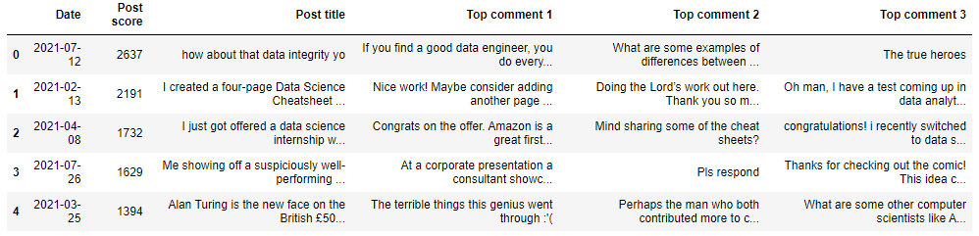
Data Collected
Date of each post
Post Karma (or score)
Post Title
The top three comments from collected posts
Karma was collected in integer format while everything else was in string format

Slide 4
Methods
A new reddit account was created to access the content through the PRAW API
Two separate nested for-loops were used to access the data
First loop was used to access everything but the comments
Data was added to respective lists
Due to how the loops displayed data a second nested for-loop had to be created.
Second loop was used to access the comments from each post
Comments were added to a central list before being sorted into another list representing their place as the top 1st, 2nd, or 3rd comment.
Lists were placed into a data frame which was then saved locally as a csv file
In the future I hope to improve this method so that the second nested for-loop can be eliminated and the process can run a bit faster.
Notes:
My initial thought was to have the loops display all the data at once but found if I displayed all three comments at once the loop also displayed all other data (title, karma, date) three times as well. This meant the data collected either had to be processed to eliminate duplicates (which had the potential to remove posts with the same amount of karma or created on the same date) or create another loop which collects only the comments but, leaves all other information intact.

Slide 5
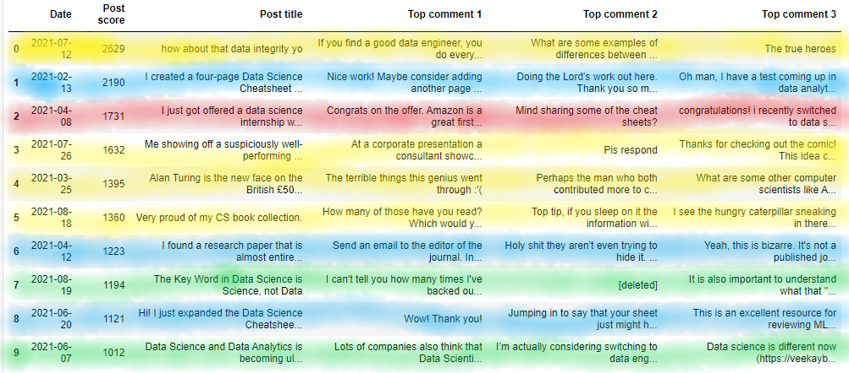
Data Insights
The average post score was 621 with a max value of 2629, min value of 340, and a range of 2289.
Our criteria did not eliminate all meme based posts. Looking at the stickies for the top 10 posts at least 4 of them were for fun/trivia which includes memes, 3 project based, 2 discussion, and 1 job related post.
One job related post seemed odd to me considering the description of the subreddit states that its “A place for data science practitioners and professionals to discuss and debate data science career questions.”
One of the project posts was an expansion of the other. 2 of the fun/trivia posts are CS related but not specifically data science. So there is some overlap in the top posts in this subreddit in terms of content.
Key: Fun/Trivia - Yellow
Projects - Blue
Discussion - Green
Job - Red
Notes:
I expected there to be a flood of meme posts despite our restrictions and for them to dominate the top 10 list. 4 out of the 10 posts were fun/trivia stickied (which can include memes). 3 were project related (although post 2 and number 9 in the table are related with 9 being an expansion on 2). The lack of job related posts indicates people might come to this sub to discuss topics they find fun in data science rather than serious work.

Slide 6
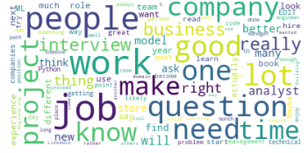
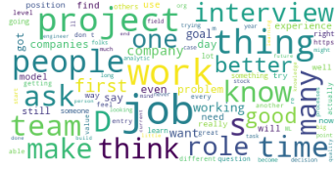
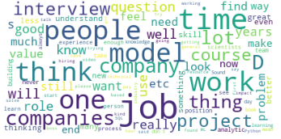
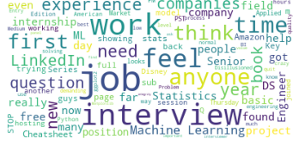
Data Insights Continued:
Word Clouds showing 100 of the most frequently used words in the comments and post titles. Frequently used words like “and”, “or”, “data”, “science” that don't bring much context were removed.
1st Top Level Comment
2nd Top Level Comment
3rd Top Level Comment
Post Titles

Slide 7
Data Insights Continued:
Looking at all of the comments several words keep cropping up frequently such as “job”, “interview”, “work”, and “project.” This could indicate that despite the lack of posts specifically related to jobs people are still discussing work related topics within these posts.
Within the post titles “job”, “interview”, and “work” were brought up alot indicating that frequently brought up posts specifically related to these topics might not be that popular hence why they don't appear in our top 10 posts.
Within the post titles there are very few actual company names are being shared as the basis for the post. Only “Disney”, “Amazon”, and “LinkedIn” were brought up in the post title.

